Slide 1
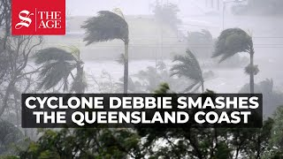
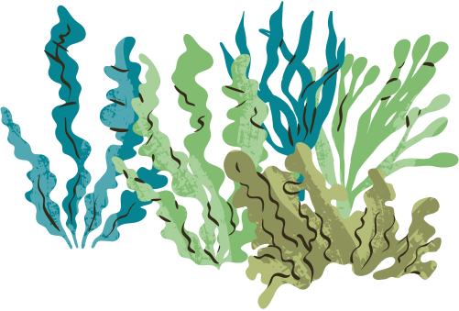

Case Study: Cyclone Debbie
Cyclone Debbie was a tropical cyclone that made landfall in Queensland in March 2017, making it a contemporary atmospheric hazard. It caused widespread hydrological and atmospheric impacts across Queensland and northern New South Wales, affecting coastal, riverine and urban environments.
Read the impacts cards to investigate the impacts of Cyclone Debbie.

Slide 2




Management and responses
In response to Cyclone Debbie, governments and emergency services implemented early warning systems and evacuations to reduce risk to life before landfall.
During and after the cyclone, emergency response teams provided rescue, medical support and essential supplies to affected communities.
In the recovery phase, governments funded infrastructure repairs, supported farmers and businesses, and improved flood and disaster management planning to reduce future risk.
Research these responses further and use evidence to determine which one is most effective and why.

